Slide 1

Machine Learning
Behavior Based Methods
Alton J Render

Slide 2

Papers Discussed
MultiAgent Reinforcement Learning: Independent vs Cooperative Agents
The Dynamics of Reinforcement Learning in Cooperative Multiagent Systems
Autonomous Shaping: Knowledge Transfer in Reinforcement Learning

Slide 3

Topic
Exploring the use of reinforcement learning to shape a robot to perform a predefined target behavior

Slide 4
Introduction
In human society, learning is an essential component
of intelligent behavior. However, each individual agent
need not learn everything from scratch by its own dis
covery. Instead, they exchange information and knowl
edge with each other and learn from their peers or
teachers.

Slide 5
Definitions
Reinforcement Learning - is an on-line technique that approximates the conventional optimal control technique known as dynamic programming.
Task is to maximize the long-term discounted reward.
(Skinner, Pavlov)
Boltzmann Distribution - in statistical mechanics and mathematics it is a probability distribution, probability measure, or frequency distribution of particles in a system over various possible states
Q-Learning Algorithm - learned decision policy is determined by the
state/action value function, Q, which estimates long
term discounted rewards for each state/action pair.
Markov Decision Process - The external world is modeled as a discrete time, finite state. This process stats that each action is associated with a reward.
Dynamic programming (also known as dynamic optimization) is a method for solving a complex problem by breaking it down into a collection of simpler subproblems, solving each of those subproblems just once, and storing their solutions

Slide 6
Boltzmann Distribution
Exploration Strategy- an agent can try its actions at any time—there is no requirement to perform actions that are currently estimated to be best.
Non Exploitive Exploration - an agent randomly chooses its actions with uniform probability.
Exploitive Exploration - an agent chooses its best estimated action with probability px, and chooses some other action with probability 1 - px.

Slide 7
Boltzmann Exploration
Often the exploitation probability px is increased slowly over time. This helps to reach the global optimum and reduces the chance of moving away from the optimum as time passes
We call a nonoptimal action choice an exploration step and 1􀀀- px the exploration probability.
Non optimal action selection can be uniform during
exploration, or can be biased by the magnitudes of Q-values

Slide 8

Boltzmann Distribution
Popular biased strategy
(e^{Q[s,a]/τ})/(∑_{a} e^{Q[s,a]/τ})
s: state
a: action
T: temperature parameter T can be decreased over time so that the exploitation probability increases (and can be done in such a way that convergence is assured

Slide 9
Boltzmann and Q-function
The existence of multiple agents, each simultaneously learning, is a potential impediment to the successful employment of Q-learning (or RL generally) in multiagent settings.
Thus, the convergence of Q-Values is not guaranteed in multiagent systems.
Will optimizations help?

Slide 10
Optimization
Optimistic Boltzmann (OB): For agent i, action ai in Ai,
let MaxQ(ai)= max􀀀pie_i Q(􀀀pie_i, ai). Choose actions
with Boltzmann exploration (another exploitive strategy
would suffice) using MaxQ(ai)as the value of ai.
Weighted OB (WOB): Explore using Boltzmann using factors MaxQ(ai) Pri (optimal match 􀀀i for ai ).
Combined: Let C(ai) = p MaxQ(ai)+(1􀀀 - p)EV(ai),for some 0 <= p <= 1. Choose actions using Boltzmann exploration with C(ai)as value of ai.

Slide 11
Multi-Agent Reinforcement Learning
Given the same number of reinforcement learning agents will cooperative agents out-perform independent agents who do not communicate during learning and What is the price for such cooperation?

Slide 12
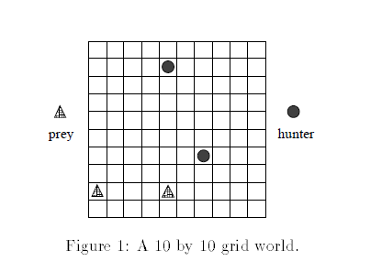
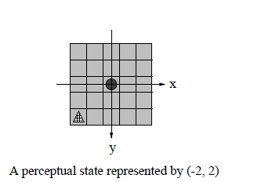
Task
Study involve hunter agents seeking to capture randomly moving prey agents in a 10 by 10 grid world

Slide 13
Cooperative Agents
How do we study them?
Sharing Sensations
(e.g. Sound,Lights, Objects)
Sharing Episodes or Episodes
(e.g. sequences of actions, sensations, rewards)
Sharing/Joint Task
(i.e. an agent is confined to a partner to accomplish a task)

Slide 14
Sharing Sensation
We want an agent to us sensory input provided by another agent.
This information is beneficial if it is relevant and sufficient for learning
Note: Cooperative agents may not learn if there is insufficient sensations from other agents

Slide 15
Sensation
For example, if the relative locations of a prey to the scout
(known) and the scout to the hunter (sensed) are (-2,2) and (2,5 )respectively, then the relative location of the prey to the hunter is (0,7).To keep the same dimension of a state representation (i.e. still use (x,y) combine sensation inputs from the hunter and the scout as follows use the hunters sensation first if the hunter cannot sense any prey then use the scouts sensation.

Slide 16
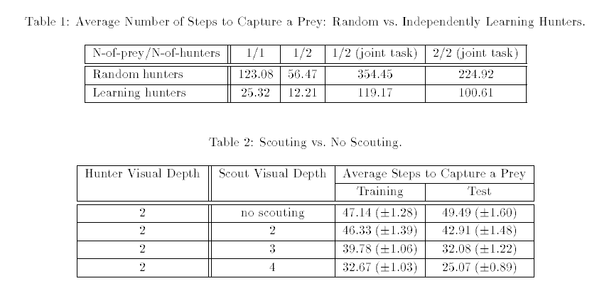
Sensation per 2000 trials

Slide 17
Sharing Policies
Assume agents do not share sensations
Cooperation between agents can speed up learning compared to independent agents.
Note: Sharing Policies is limited to homogeneous agents while sharing episodes can be used by heterogeneous agents as long as they can interpret them

Slide 18
Intuition
One simple way of cooperating is that hunters use the
same decision policy Although each hunter updates
the same policy independently the rate of updating
the policy is multiplied by the number of hunters per
step
The average information communicated by each same-policy hunter per step is bounded by the number of the bits needed to describe a sensation an action and a reward 2log2(2Vdepth +1) + 3

Slide 19
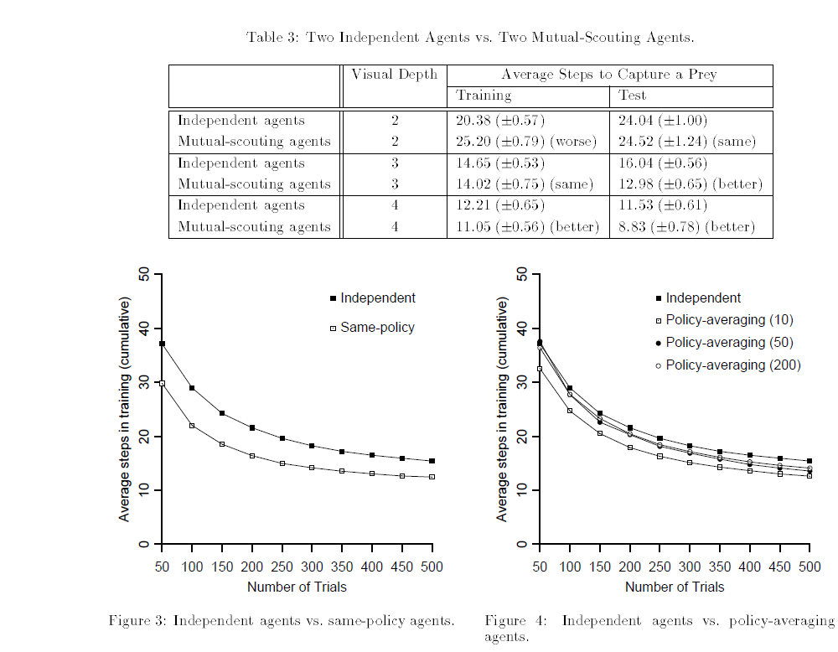
Sharing Policy Graph

Slide 20
Joint Task
Cooperative agents who sense their partners
or communicate their sensations with each other can
learn to perform the tasks at a level that independent
agents cannot reach even though they start out slowly

Slide 21
Intuition
Hunters cooperate by either passively observing each other or actively sharing their sensations and locations. This is demonstrated in that cooperative agents
can learn to perform the joint task significantly better
than independent agents although they start slowly.

Slide 22
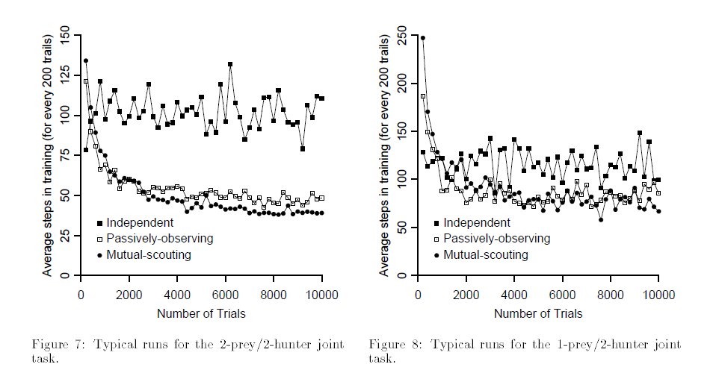
Joint Task Graph

Slide 23
Cooperative Agents(conclusion)
Cooperative reinforcement learning agents can learn faster and converge sooner than independent agents via sharing learned policies or solution episodes
Cooperative agents can also broaden their sensation via mutual scouting and can handle joint tasks via sensing other partners
However, extra sensory information can interfere
with learning,and sharing knowledge or episodes comes
with a communication cost, and it takes a larger state
space to learn cooperative behavior for joint tasks

Slide 24
Summary
Reinforcement Learning
Boltzmann Distribution
Q-Learning Algorithm
Markov Decision Process
Cooperative Agents
Sharing Sensations
Sharing Episodes or Episodes
(e.g. sequences of actions, sensations, rewards)
Sharing/Joint Task
(i.e. an agent is confined to a partner to accomplish a task)

Slide 25
Related Work
ALPHAGo- Uses reinforcement learning to play itself and redefine supervised learning technique

Slide 26


